Slide 1
Software Engineering and Architecture
Broker Pattern
Architectural Pattern for
Remote Method Invocation

Slide 2
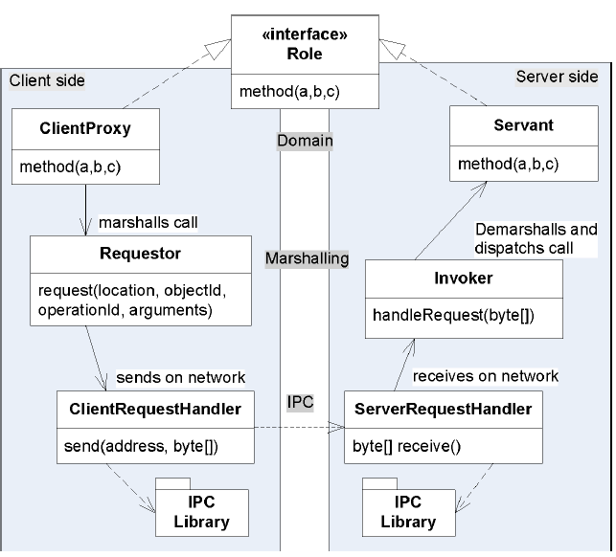
Broker
Broker bundles the
four elements:
Solutions are
  Request/Reply protocol
  Marshalling
  Proxy Pattern
  Naming Systems

Slide 3
Broker
Broker bundles the
four elements:
Solutions are
  Request/Reply protocol
  Marshalling
  Proxy Pattern
  Naming Systems

Slide 4
Broker
Broker bundles the
four elements:
Solutions are
  Request/Reply protocol
  Marshalling
  Proxy Pattern
  Naming Systems

Slide 5
Broker
Broker bundles the
four elements:
Solutions are
  Request/Reply protocol
  Marshalling
  Proxy Pattern
  Naming Systems

Slide 6
Broker
Broker bundles the
four elements:
Solutions are
  Request/Reply protocol
  Marshalling
  Proxy Pattern
  Naming Systems

Slide 7
A Picture of the ‘Flow’
The method call
flows from the client’s
ClientProxy, through
intermediaries until
it ends in the Servant
  Each intermediate
  responsible for a
  transformation
    domain-to-network
    and vice-versa
… and back again…
  “Chained calls”

Slide 8
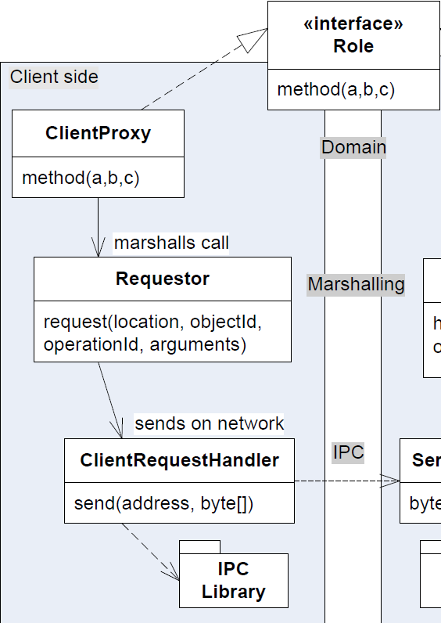
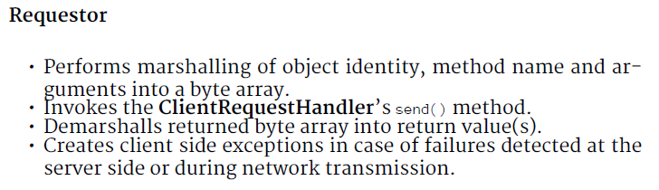
The ‘Side’ Perspective
Client side

Slide 9
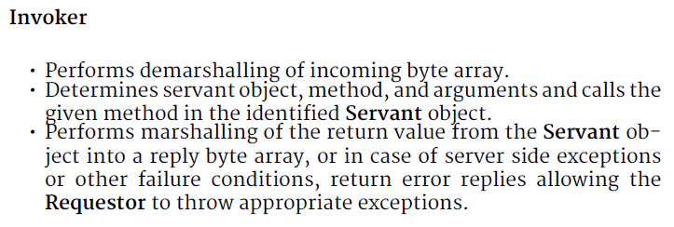
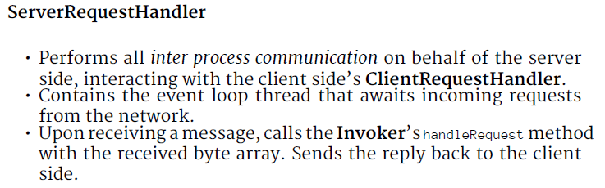
The ‘Side’ Perspective
Server side

Slide 10
Dynamics (Client)

Slide 11
Dynamics (Server)

Slide 12
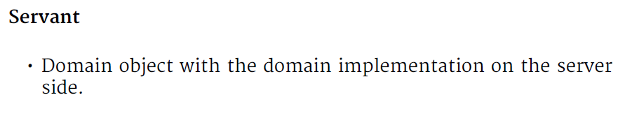
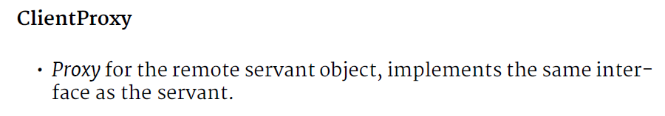

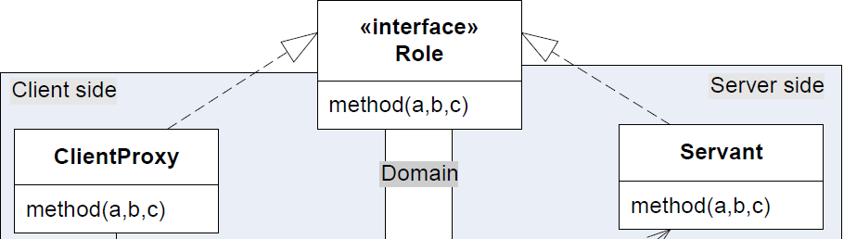
Domain Level
Domain level represents the actual Role

Slide 13
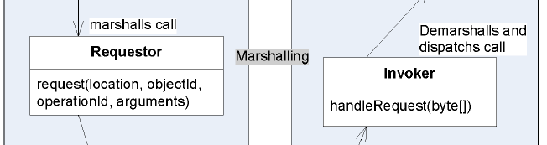
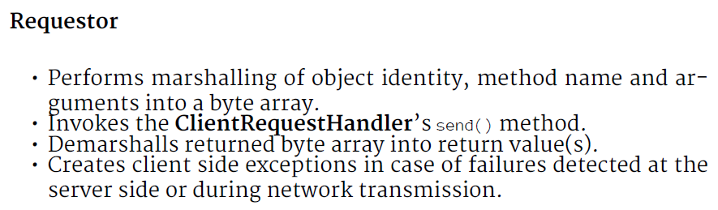
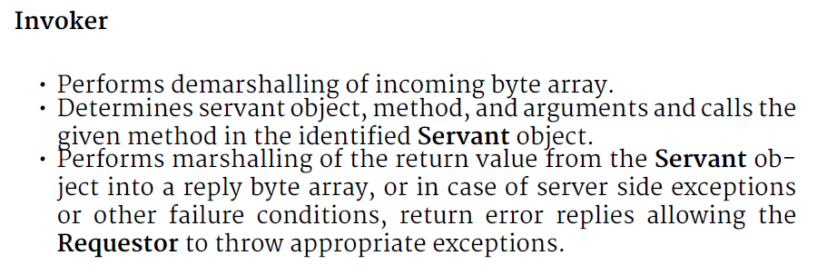
Marshalling Level
Encapsulate translation
to/from bits and objects

Slide 14
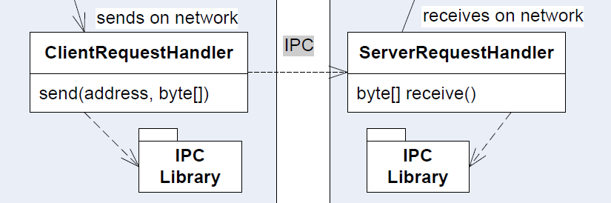
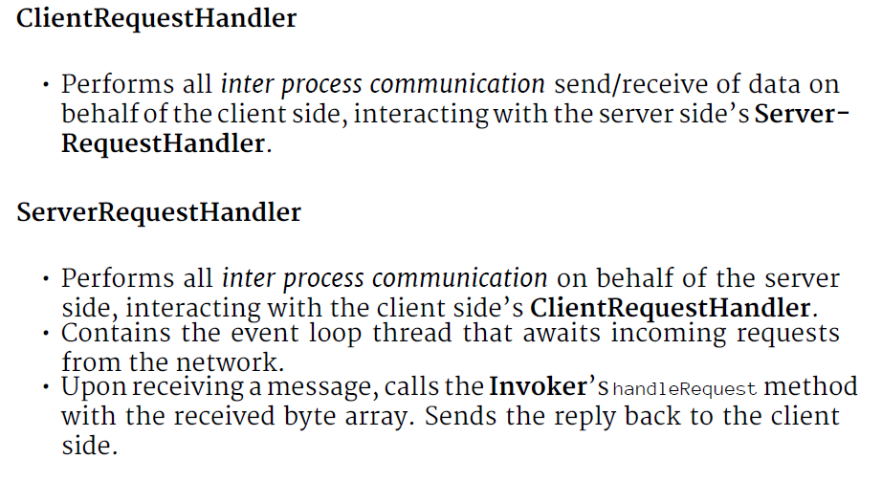
IPC Level
Interprocess Communication
  Encapsulate low-level OS/Network communication

Slide 15
Relating to ③ ① ②
Broker pattern and ③ ① ② ?
  Yes, yes, and yes
③ Encapsulate what varies
  We would like to vary marshalling format: Requestor+Invoker
  We would like to vary IPC method : xRequestHandler
② Object composition
  We delegate to the requestor. We delegate to the RequestHandl.

Slide 16
In Practice
How Does It Look Then…

Slide 17
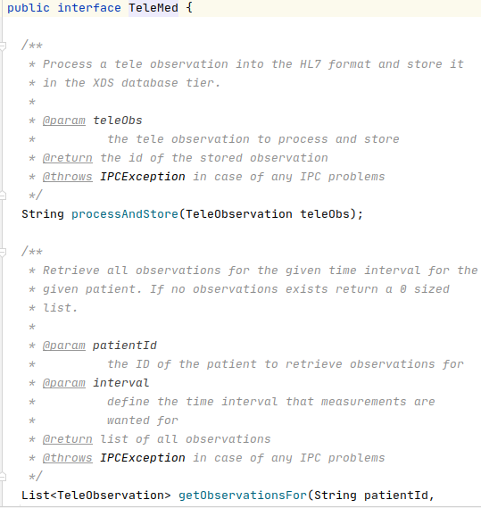
The TeleMed Interface
Will only look at the two
methods to
  Upload
    processAndStore
  Download
    getObservationsFor

Slide 18
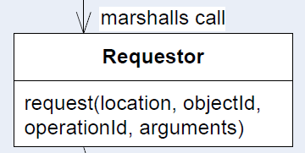
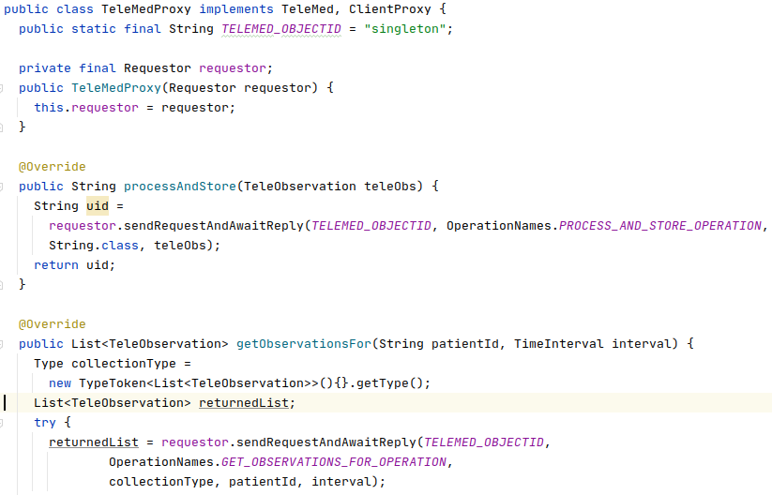
TeleMed Proxy
ClientProxy =
Proxy calls
Note: There is only a single TeleMed servant object. Thus the objectId is ‘not applicable’
Note: location = server, is provided as a global parameter, and not part of parameter list…

Slide 19
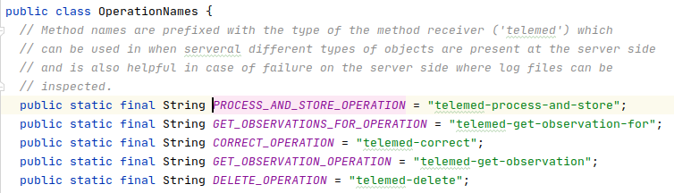
Identity of Methods
Remember: We can only send byte arrays aka. Strings
Need to Marshall method names as well.
”Mangling” = Concatenate class name and method name

Slide 20
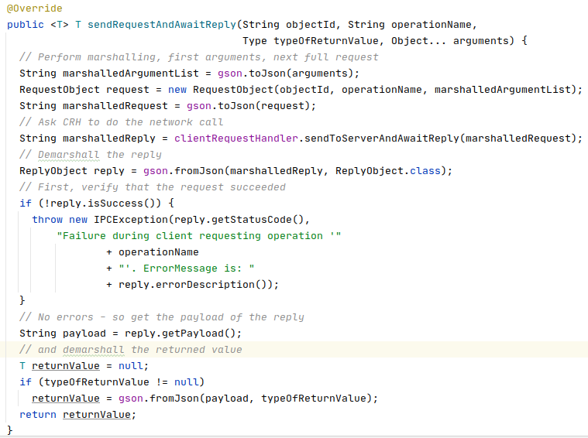

Requestor
General Implementation!
Use JSON and the GSON
library
Generic return type is
pretty helpful…
And Object… = arrays of
mixed types are really
nasty that required some
googling to find out how.
This is code provided by the FRDS.Broker library!

Slide 21
Request Handlers
Let us skip them for the moment…
Basically they are responsible for the request/reply protocol
Broker Library code base come with two variants:
  Socket: Raw Java TCP/IP network implementations
  HTTP: Use as a raw transport (URI Tunneling)

Slide 22
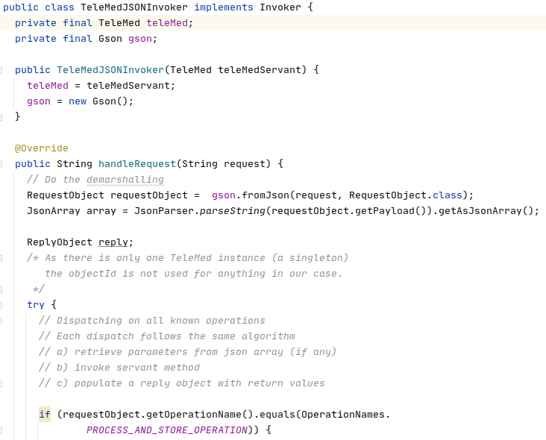
Invoker
Basically you need a large
switch on each method
name to do the ‘upcall’,
and extract the relevant
parameters for the method
Demarshall into (objectId, operation name, arguments)
For multi-object system, you need something more complex. Stay tuned – we will look at it next week...

Slide 23
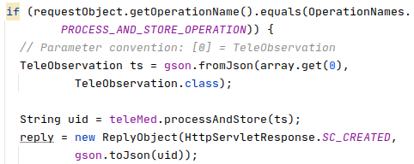
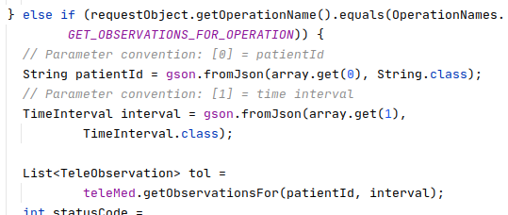

Invoker
Once the method is determined, parameter list can be demarshalled, and the upcall made…

Slide 24
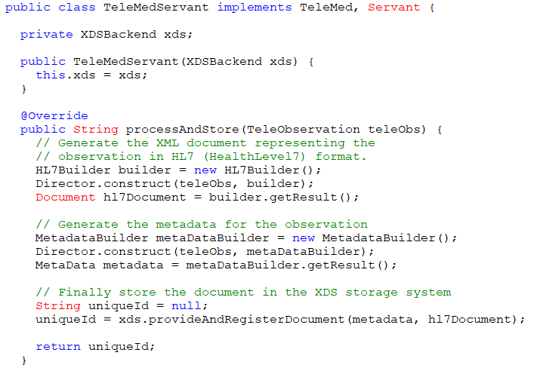
TeleMed Servant
Servant =
Domain
implementation
Not really
relevant for
Broker, but
for the system ☺

Slide 25
Summary
The flow

Slide 26
Summary
It is a Framework !
Only roles
  ClientProxy
  Invoker
… are TeleMed specific!
(… and HotStone
specific!)

Slide 27
Limitations
No Name Service / Registry required for TeleMed
  Parameterized which machine the servant object resides on
    Use DNS as kind of registry, defaults to ‘localhost’
  More RPC than RMI
    Remote Procedure Call on ‘single type object’, not on multiple objects
Only Value types can be passed, not Reference types
  No object references ever pass from client to server!
Asymmetric
  Client-server protocol, no ‘callback’ from server possible
  I.e. The Observer pattern can not be implemented
We treat String as pass-by-value

Slide 28
Why No Call Backs to Clients?
Because server calling clients is BAD ☺ !
No no no. Nothing is every ‘good’ or ‘bad’ in science ☺
  WarpTalk is all about ‘call back from server to clients’ ☺
We will return to why ‘servers should not call clients’ in next week…

Slide 29
Deployment
In the code bases distributed, the client and server side classes are pooled into one big source tree
  src/
In real deployments you need to split’em
  Server: Server side specific classes
  Core: Core domain interfaces and PODOs
  Client: Client side specific classes
The client side deployment (Core + Client)
The server side deployment (Core + Server)
Simply easier in our teaching

Slide 30
The Process?
How did I get there?

Slide 31
Developing it
All well – you see the final picture but how was it painted?
Challenge: TDD of a distributed system?
  I cannot (easily) automate that a server needs to be running on some remote machine, can I?
    (Well we can, but that is another course…)

Slide 32
Exercise
Which level hinders TDD???
  Or rather automated testing
And you know how to deal
with it, right?!?
What is the answer???

Slide 33
Principle 1+2+Doubles
It is the IPC Level that hinders TDD
But
  Programmed to an interface
  Object compose a Test Double
  into place instead!!!
    A Fake Object IPC

Slide 34
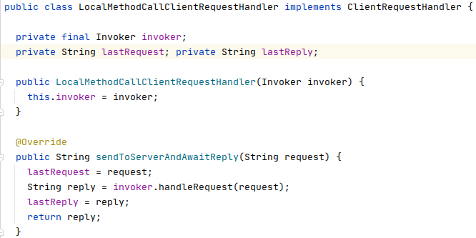
Faking the IPC
No need to start server.
No concurrency.
All aspects (except IPC) can be TDD’ed
LocalMethodCall
ClientRequestHandler

Slide 35
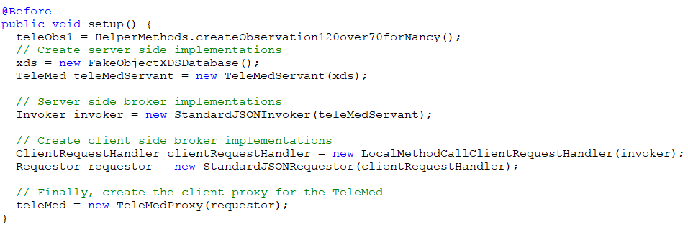
@BeforeEach
Binding the Broker / Coupling the delegates together
That is
  Link proxy to requestor, requestor to CRH double, CRH to invoker, and the Invoker to the servant object
The only test double!
The rest are production code!

Slide 36
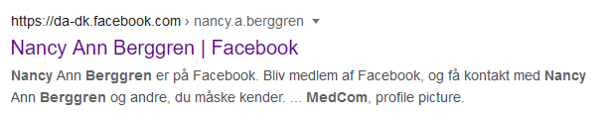
Fun Fact
Nancy?
  A fictive person which exists in all Danish medical systems
She even has a face book profile ☺

Slide 37
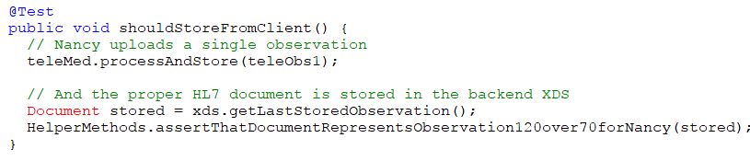
Make a Test Case
Call client proxy, assert something stored in XDS
‘xds’ is both Spy and FakeObject

Slide 38
The IPC Level
Talking network’ish

Slide 39
Choosing IPC
The most fundamental level
  Sockets
More modern approach
  URI Tunneling using HTTP web servers

Slide 40
Rule #1
Find stuff on the internet ☺
  Jakob Jenkov has fine tutorials on socket server programming
    Single thread
    Multi thread
    Thread pooled
Question of concurrency
  Single thread Only one call at the time
  Multi thread Unlimited => Memory exhausted!
  Thread pool N threads = Best of both worlds

Slide 41
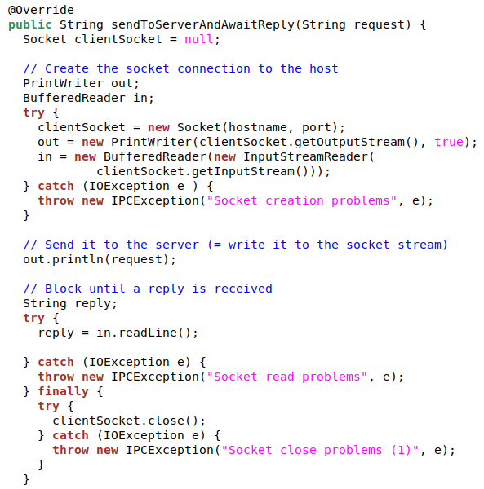
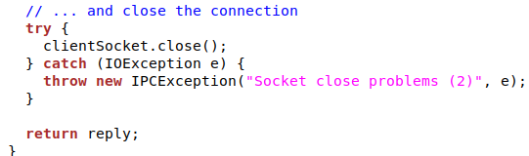
Client Request Handler
Socket
  “modificed EchoClient"
The old HTTP protocol
  Create socket
  Send request
  Read reply
  Close socket
Inefficient but reliable

Slide 42
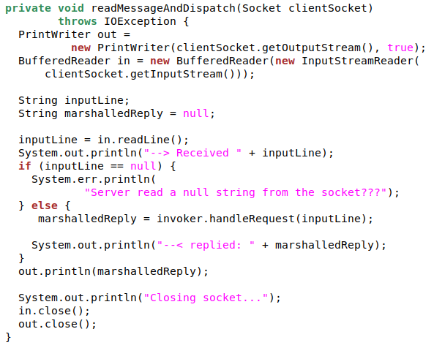
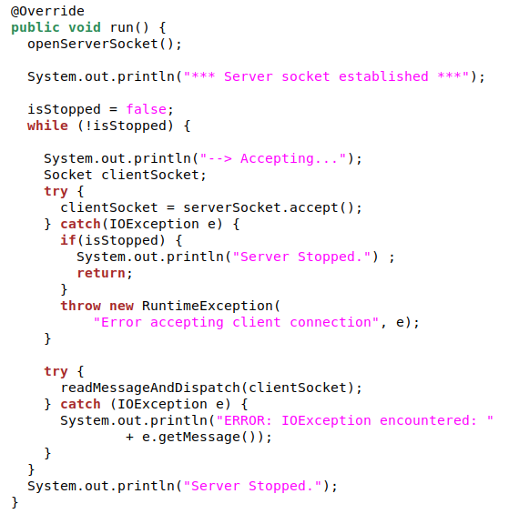
Server Request Handler
Jenkov single thread
  Accept incoming socket
  Read request
  Call invoker
  Send reply
  Close socket

Slide 43
Summary

